Slide 1

How to really use ChatGPT mentions

Slide 2

“Mention this to me
Mention this to me
And watch the weather change […]”
- Tool, Disposition (Lateralus 2001)

Slide 3

What are GPT Mentions?
Notes:
https://www.youtube.com/watch?v=uP_XsZwsTVM
https://community.openai.com/t/custom-gpt-mentions-in-chatgpt-plus/608136
https://www.zdnet.com/article/chatgpt-plus-users-can-now-add-relevant-gpts-to-their-chats-heres-how/

Slide 4
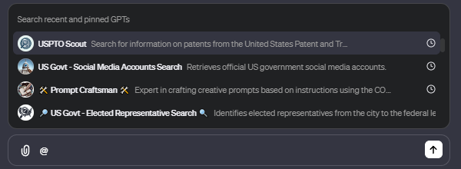
Reference any GPT directly from chat

Slide 5
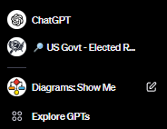
What GPTs will show up?
Pinned
Recent

Slide 6
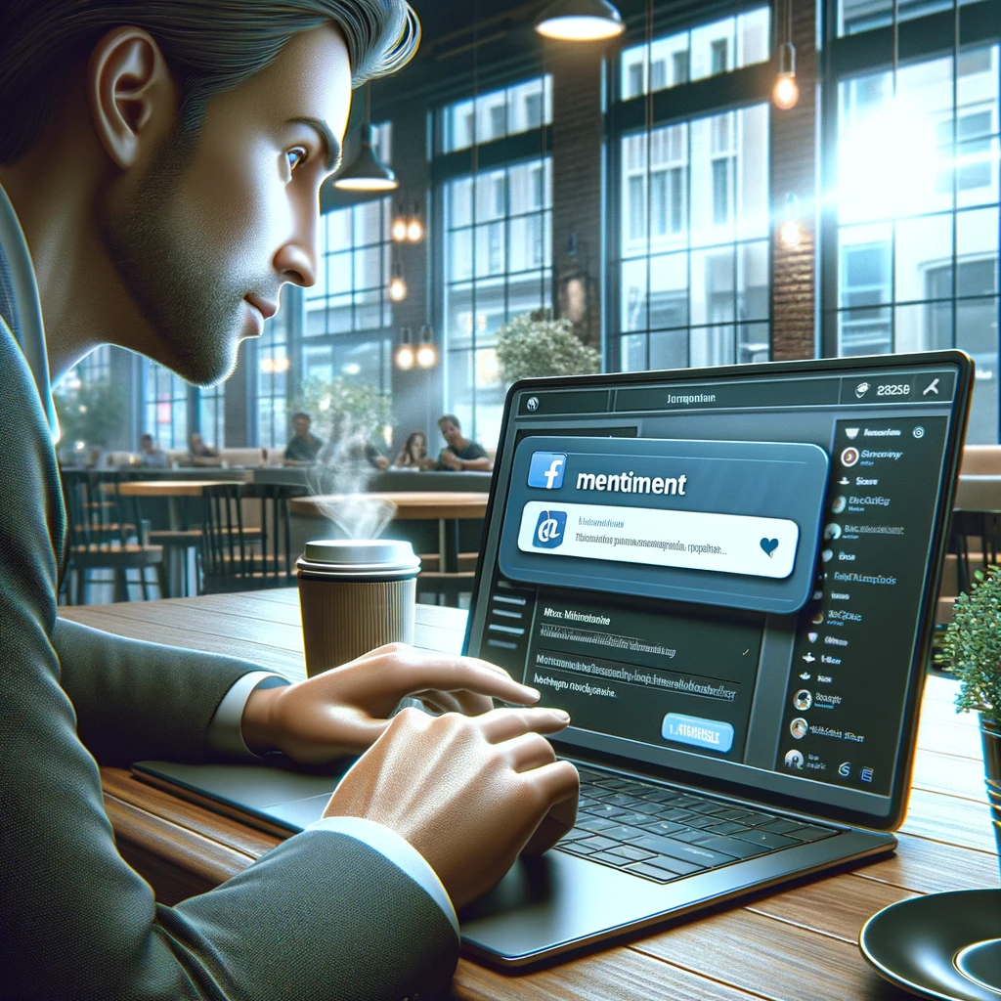
How do I use GPT mentions?

Slide 7
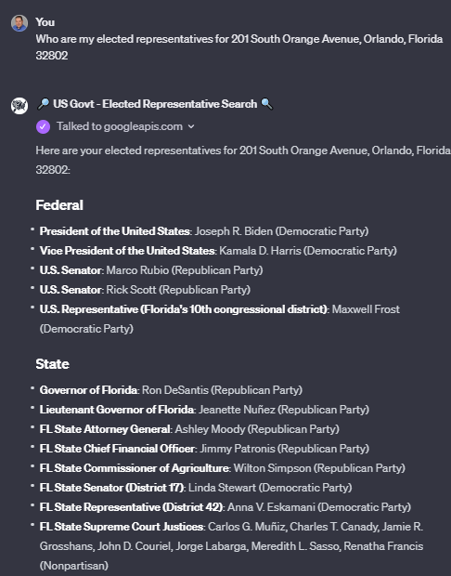
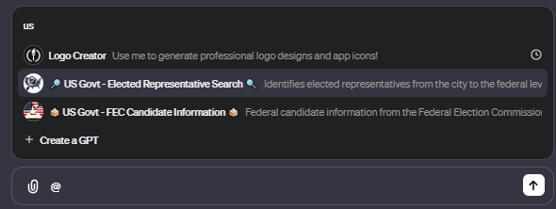
standalone
Notes:
Who are my elected representatives for 201 South Orange Avenue, Orlando, Florida 32802

Slide 8
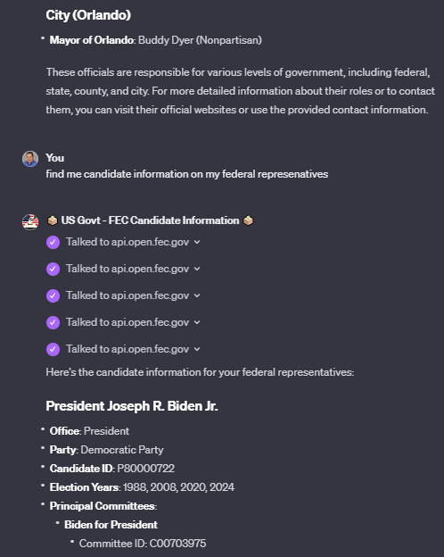
chained with other GPTs

Slide 9

Managing mentions

Slide 10
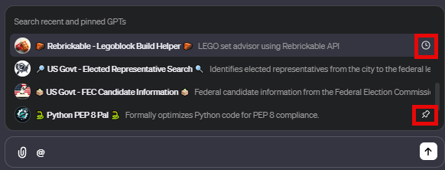
recent vs pinned GPTs

Slide 11
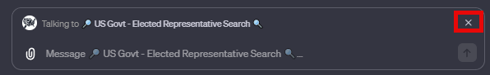
Ending a mention in chat

Slide 12
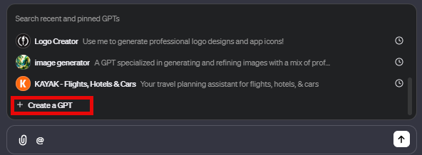
Creating a GPT to mention

Slide 13


